Slide 1
GHG Emission Reduction Plan
Nevada Transportation Conference
My-Linh Nguyen, Environmental Division
Kandee Bahr Worley, Sustainability & Emerging Transportation
May 7, 2024

Slide 2
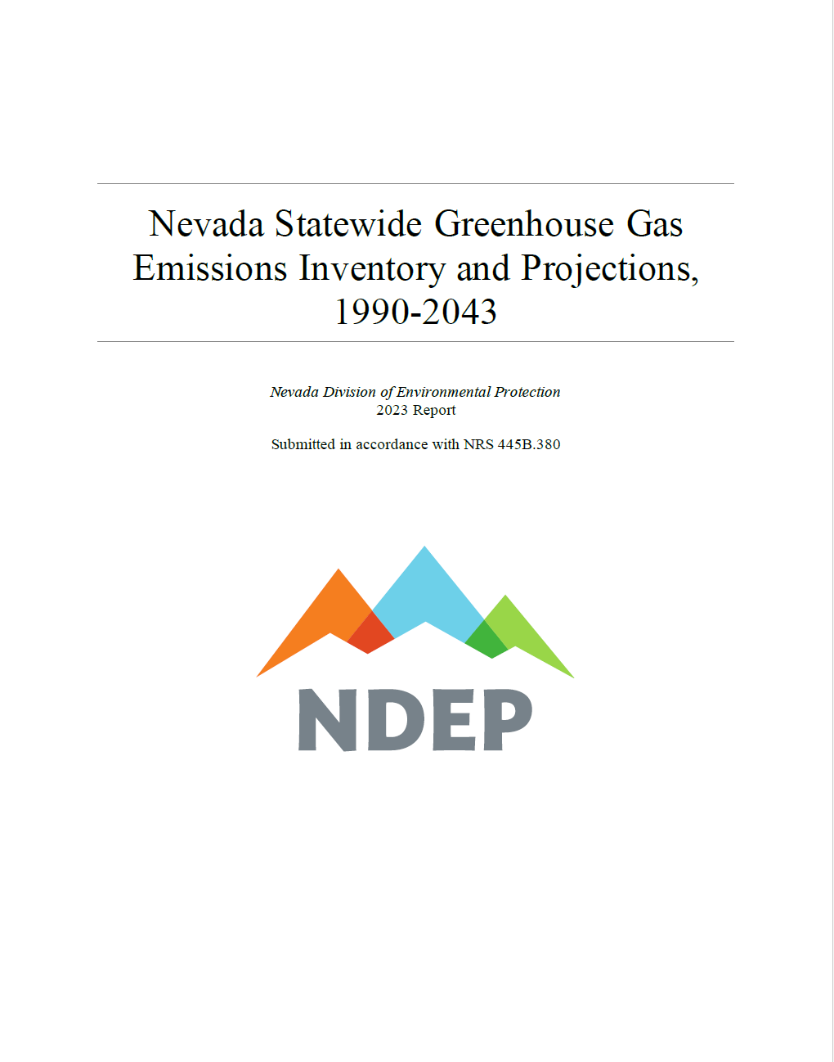
Nevada Revised Statutes (NRS) 445B.380
Beginning in 2019, and each year thereafter:
Issue a report of statewide inventory of GHG emissions & a projection of GHG emissions in the State for the 20 years immediately following the date of the report
Includes sources and amounts of GHG emissions from:
  (1) Electricity production
  (2) Transportation
Statement of policies aimed at reducing net emissions (compared to 2005 baseline):
  28% by 2025
  45% by 2030
A qualitative assessment of whether policies support long-term reductions of GHG emissions to zero or near-zero by the year 2050.
https://ndep.nv.gov/air/air-pollutants/greenhouse-gas-emissions
Notes:
Why?
Beginning in 2019, state laws require the State Department of Conservation and Natural Resources to issue annual reports of GHG emissions and a projection of GHG emissions for the state for the 20 years immediately following the date of the report. The report Includes:
sources and amounts of emissions from electricity production and transportation.
Statement of policies aimed at reducing net emissions by 28 % by 2025 and 45% by 2030 compared to the 2005 baseline.
Also includes a qualitative assessment of whether the policies support long-term reduction of GHG emissions to zero or near-zero by the year 2050.

Slide 3
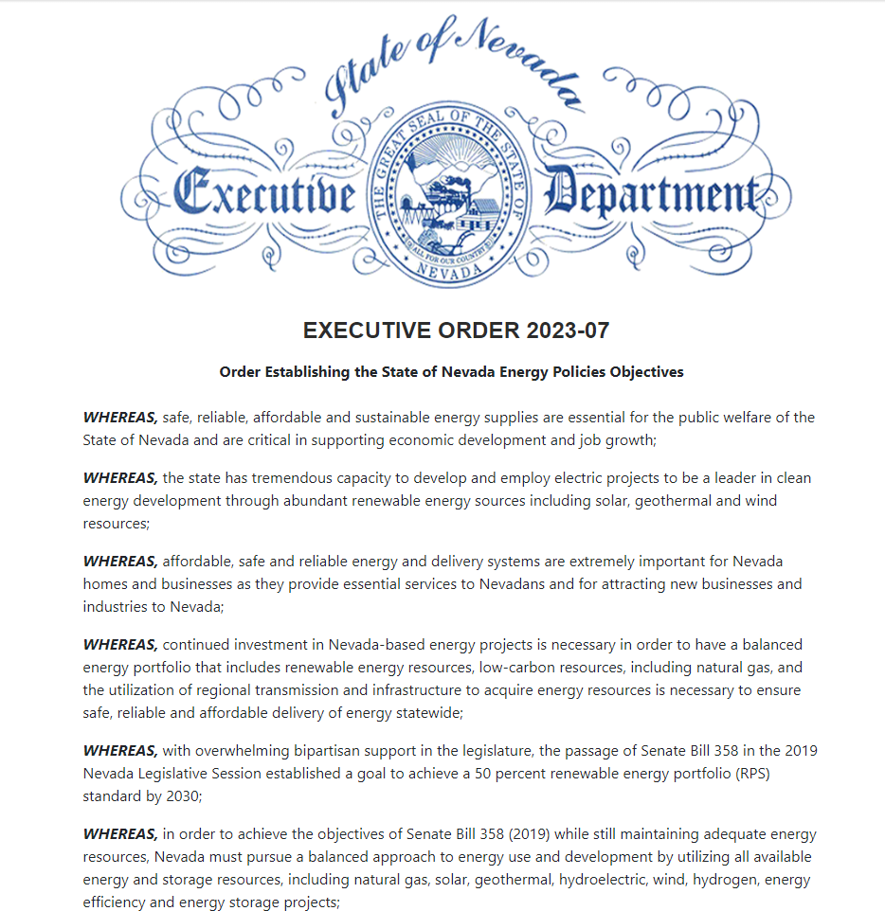

Executive Orders
EO 2019-22: State agencies to identify & evaluate policies and regulatory strategies to achieve long-term goals of GHG emission reductions
State Climate Strategy (2020): focused on carbon pollution from electricity and transportation sectors, buildings, state operations, and relevant sectors.
EO 2023-07: Review and revision of the Nevada Climate Strategy involving a broad-based stakeholder effort.
  Priority Climate Action Plan (2024): six focus areas – Transportation, Buildings, Energy Systems, Industry, Waste Reduction, Restore Landscapes and Sequester Carbon.
Notes:
Furthermore, in 2019 executive order 2019-22 orders executive branch to identify and evaluate policies and regulatory strategies to advance Nevada’s Climate goals. The order also requires state agencies including NDOT to participate in the development of the State Climate Strategy, due by December 1, 2020.
In 2023 executive order (07) establishes the State of Nevada Energy Policy Objectives (to pursue a robust and diverse energy supply portfolio). Section 9 of the order requires the review and revision of the Nevada Climate Strategies, as needed involving a broad-based stakeholder effort to support the energy objectives.
In February 2024, the NDEP completed the Nevada Priority Climate Action Plan. This plan identified priority measures to reduce GHG emissions in six focused areas, including transportation, Buildings, energy systems, industry, waste reduction, and restoring landscapes and sequestering carbon.

Slide 4
Provide leadership in reducing GHG emissions through a combination of strategies in operations, planning, design, construction, and maintenance of existing and future transportation systems.
NDOT’s Actions
Reduce GHG emissions from NDOT daily operations
Reduce GHG emissions NDOT administered transportation facilities
Reduce GHG emissions in NDOT funded programs
Notes:
What is NDOT”s role?
According to NDEP’s annual reports, Transportation has become the largest GHG emission sector in the State since 2015 and accounts for ~40% of total statewide net emissions.
In 2020, The Nevada Department of Transportation established a policy in support of the State’s effort to reduce greenhouse gas emission and achieve statewide goal.
This policy states that NDOT will:
We aim to address this policy by looking at opportunities to reduce GHG emissions from our daily operations, our administered transportation facilities, and our funded programs. In this presentation, I will cover the operations, and my co-presenter, Kandee Bahr Worley, will discuss efforts to reduce GHG emissions in our transportation facilities and funded programs.

Slide 5
Coordinating Committee and GHG Strategy Workgroup
NDOT Management
Planning
  Multi-modal
  Performance Analysis
  Innovation
Project Delivery
  Environmental
  Project Management
  Roadway Design
  Construction
Operations
  Administrative Services
  Equipment Management
  Materials
  Maintenance & Asset Management
  Traffic Operations
Districts 1,2,3
Communications
Notes:
How did we do it?
6 Coordinating committee members: Planning and Project Delivery
18 workgroup participants (12 Divisions and 3 Districts, Communications and Management)

Slide 6
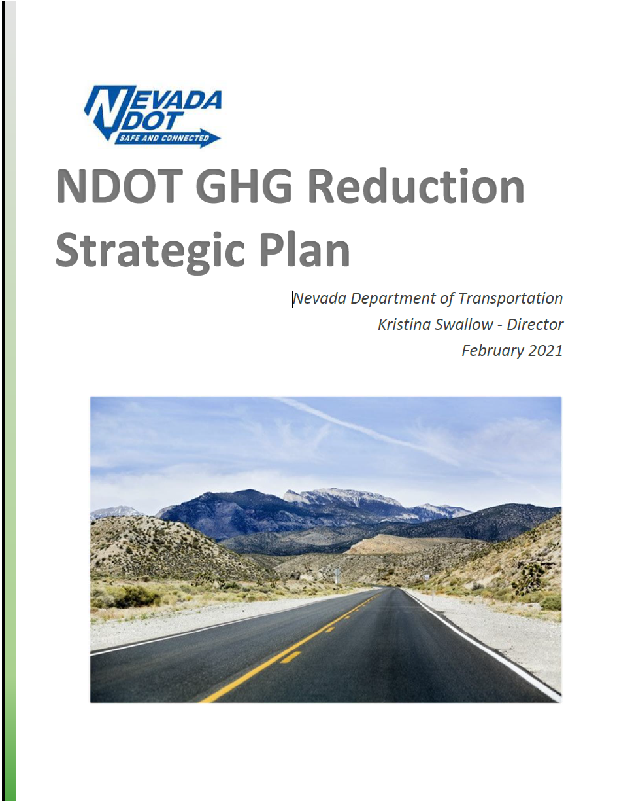
2021 NDOT GHG Reduction Strategic Plan
Annual GHG emission inventory from NDOT Operations
GHG reduction Strategies
  Operations
  Design-Construction
  Planning
NCHRP 25-56 (study) Reducing Greenhouse Gas Emissions: A Guide for State DOTs (March 2022).
Notes:
Beginning in June 2020: the workgroup began to document GHG emissions in NDOT current administrative operations and review opportunities and practices to reduce GHG emissions.
Our efforts were guided by the Transportation Research Board’s on-going project: NCHRP 25-56 (led by Cambridge Systematics) at the time, and this guide was published as A guide for State DOTs March 2022.
For our part, NDOT finalized the GHG Reduction Strategic Plan in early 2021. This document included the annual (baseline) emission inventories for FY 2019 and 2020 and include 24 GHG reduction strategies including:
9 – operations
11 – Design and Constructions
4 - Planning

Slide 7
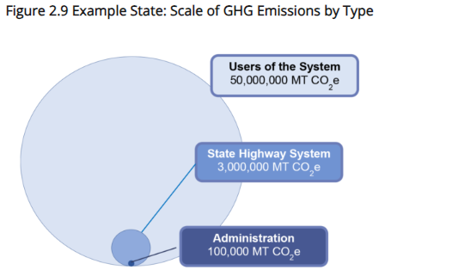
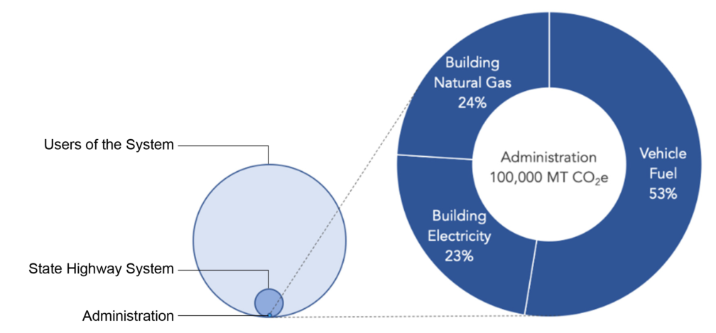
Typical Transportation Sector GHG emissions
Figure 9.1 Sources of GHG - DOT Administration
Source: Reducing Greenhouse Gas Emissions: A Guide for State DOTs (March 2022, Transportation Research Board: NCHRP Webresource 1). https://crp.trb.org/nchrpwebresource1/
Notes:
Drawing from examples from the referenced NCHRP study for State DOTs, Typical GHG emissions from Transportation sector includes:
Overall users of the system generates the vast majority of GHG emissions: 50M Mt CO2e annually (combustion of fuels for passengers and freight transport)
Materials and fuel used in the constructions, maintenance and operation of the State HWY system account for 3M Mt CO2e (6% of System users)
Department of Transportation Administrative operations (office buildings and vehicles): 100K Mt CO2e (.02% of the System users)…
Vehicle fuel from DOT >50%
Electricity: 23%
Natural Gas 24% (building) – Stationary source

Slide 8



NDOT GHG Inventory
Three Primary Steps
  Define the Boundary/Scope
  Collect Data
  Quantify GHG Emissions
https://www.epa.gov/climateleadership/center-corporate-climate-leadership-simplified-ghg-emissions-calculator
Notes:
How did NDOT account for our Administrative operation emissions?

Slide 9
NDOT Inventory Scope
Scope | GHG source | Data type
1 – Direct | Mobile | Fuel purchase for vehicles owned or leased
 | Stationary | Energy purchase for on-site use
 | Fugitive | Refrigeration and AC equipment
2 – Indirect | Electricity | Electricity purchase
3 – Other indirect emissions | Business travel | In and out-of-state travel records
 | Employee commute | HR records, average daily commute estimate
 | Waste generated in operations | Municipal solid waste Construction & maintenance waste Recycling
Notes:
gasoline, diesel, biodiesel, CNG, jet fuels, Ethanol
natural gas, propane, heating oil
AC & Refrigeration: facilities & mobile equipment

Slide 10
NDOT GHG Inventory Summary
Notes:
Our effort began mid FY 2020 (COVID-19 shutdown), so we picked FY2019 (pre-covid) as baseline to compare.:
19-20: -11.6% (19-21: -17%) (19-22: -21.5%) (19-23: -17.3%)
20-21: -6.1%
21-22: -5.4%
22-23: +5.3%
In 2021, improved our method to document fugitive sources to include AC from mobile equipment.

Slide 11
NDOT Administration GHG Emission by Source
Notes:
Largest emission source: vehicle fuel usage (mobile source)
Electricity has the second largest emission source
Notice that; in FY 2019, employee commuting has similar share of GHG emission source. Since 2020 (social distancing and hybrid-telework policy) resulted in noticeable reduction in emissions from commuting and business travel.

Slide 12
Current Practices
Measure | Implementation | Estimated GHG savings, Mt CO2e per year
O-2: Energy-efficient or alternative fuel light-duty vehicles (AFV). | light duty Biodiesel capable vehicles light duty AF-capable vehicles electric vehicles | 249 (avg.)
O-5: Install more energy-efficient roadway lighting. | Replaced 640 high mast HPS fixtures with LED lighting along a portion of I-15. | 205*
DC-4: Alternative energy capture | Installed 241.5 kW of solar capacity at NSRS and ITS sites. | 246*
DC-11: Install more energy-efficient roadway lighting | Updated LED lighting specifications for new installations and replacements for maintenance contracts (2021 – 2025). | 373*
*Estimate using EPA GHG Equivalencies Calculator (2024).
Notes:
Equipment (O-3): replaces older vehicles with new cleaner burning lower emission versions:
350 light duty vehicles capable of using alternative fuel (E85) and 112 light duty vehicles cable of using Biodiesel are currently used in Clark County.
3 electric vehicles.
*Biodiesel usage resulting in annual (average) offset of ~249 Mt CO2e/year (average 2019-2023)
17.7% decrease mobile source emission ,FY 19-23)
Total from these measures: Removing 256 gas-powered vehicles from the road for one year.
District 1 (O-5): Estimated reduction of 293,760 KWh electricity (205 Mt CO2e) per year.
Traffic Operations (DC-4): increases use of solar power for remote communication sites. By 2023, the Department has installed 241.5 kW of solar capacity at NSRS and ITS sites (352,590 kWh per year).
Traffic Operations (DC-11): installed LED lighting all new installations and replaced HPS fixtures with LED on all maintenance contracts between 2021 – present. Estimated reduction of 534,480 KWh electricity per year.

Slide 13
Current Practices
Measure | Implementation | Status
Operations: (O-2) | Changes light fixtures to LED, replace windows, replace heating/AC equipment as -needed. | On-going maintenance activity.
Design & Construction: (DC-10, DC-2) | Continues reusing and recycling construction materials (RAP, PCCP). | On-going per project basis.
 | Replacement of ordinary portland cement (OPC) with portland limestone cement (PLC).
Traffic Operations: (DC-5, DC-6, DC-7, DC-9) | Traffic management and control with Integrated corridor management. | Project concept recommendations complete, being placed on the STIP.
DC-6 | Improves traffic flow and reduce congestion and idling by design the shortest idle times and detours. | On-going effort - projects with traffic control & traffic management plans.
 | Reduce traffic delays and vehicle miles traveled through construction work zones.
DC-7 | Provides real-time travel information to reduce congestion. | Updated the 511 System in 2022
Notes:
TSMO strategies: Smart Work Zones, 511 Traveler Information, Dynamic Message Signs, Traffic Incident Management Plans, and Temporary Traffic Control Plans
Here are a few more examples of GHG measures the Department has implemented.
As an example: DC-2, replacement of ordinary portland cement with PLC (when fully implemented) would decrease our carbon dioxide emissions by about 4,000 tons (8 million pounds) per year – equivalent to removing about 870 cars from the road for the year.

Slide 14
Lessons Learned…
Annual GHG emissions from NDOT operations has decreased compared to 2019 (17% in 2023).
  Mobile emission is the largest source (>50%) and has decreased since 2019 (17.7% in 2023).
Team effort involving multiple NDOT Divisions and all 3 Districts
  Dedicated staff to track and coordinate GHG reduction measures.
  Air-Quality/GHG specialist position filled in April 2024.
Development of user-friendly centralized inventory database:
  Waste management and Recycling database
  Continue refining inventory for AC and refrigeration
  Improve documentation for procurements and replacement
Notes:
What have we learned in this process:
2023 Legislature approved a new Air-Quality/GHG staff specialist position within the Environmental Division to support these efforts.
Additional efforts would be needed to update inventory of the resources ~100 NDOT facilities throughout the State.

Slide 15
A Team effort!
Thank you!
My-Linh Nguyen, PE.
Chief Environmental Engineer mnguyen@dot.nv.gov| 775-888-7686
Notes:
Now, Kandee will discuss the NDOT Transportation Emission Reduction Program.

